Slide 1
Technical Java Training
Green Bamboo Residence
19 Juni s.d 11 Juli 2019

Slide 2
Syllabus
Java Fundamental
Database Fundamental Using PostgreSQL 10+
Spring Framework
Spring Data JPA with Hibernate
Jasper Report

Slide 3
Java 101

Slide 4
Java 101 Syllabus
About Java
Using IDE
Basic Java Programming
Conditional and Looping

Slide 5
About Java

Slide 6
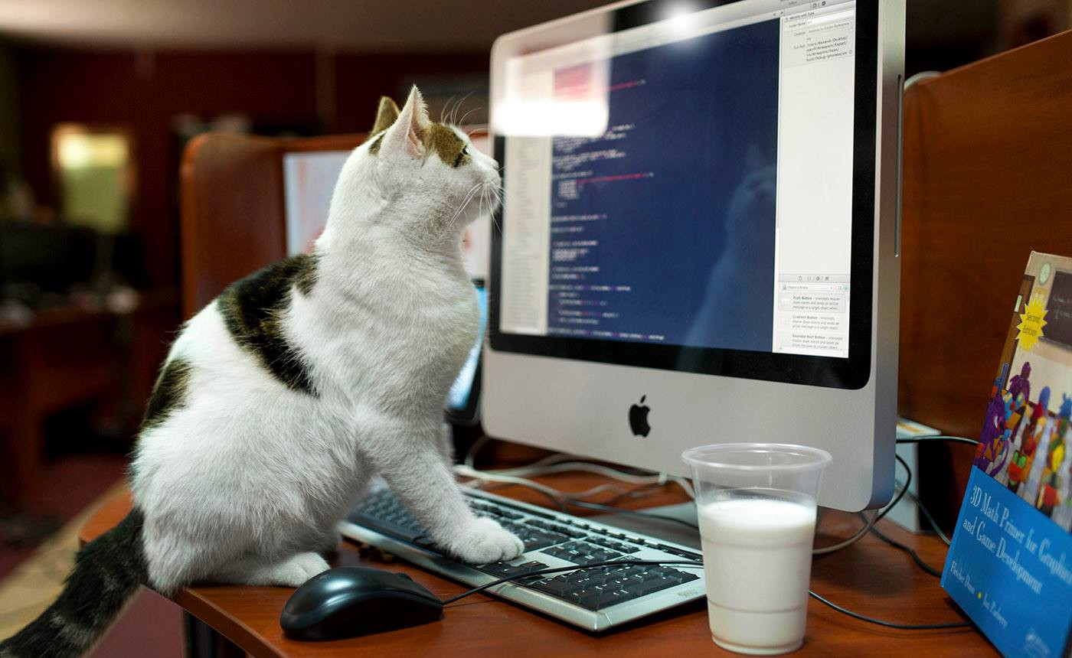
Computer Programming
Computer programming is the process of designing and building an executable computer program for accomplishing a specific computing task.

Slide 7
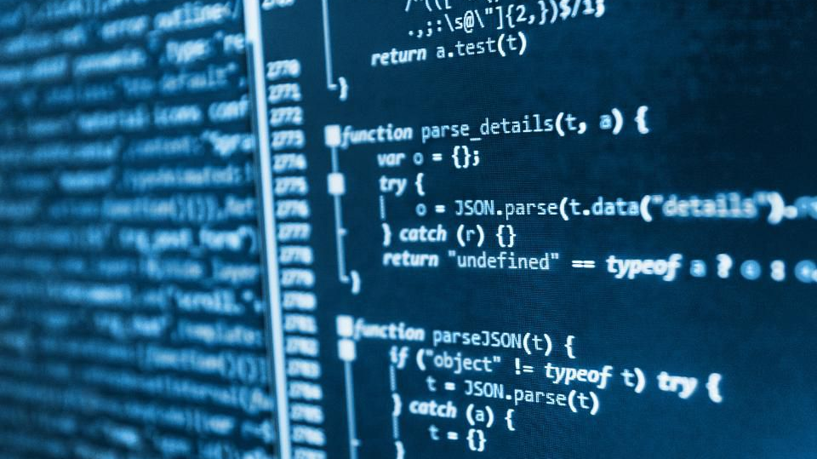
Programming Language
A programming language is a formal language, which comprises a set of instructions that produce various kinds of output. Programming languages are used in computer programming to implement algorithms.

Slide 8
Programming
Write Program in “Human Language”
Computer Interpret it as It’s own language
Do Stuff

Slide 9

Java
Java is a general-purpose programming language that is class-based, object-oriented, and designed to have as few implementation dependencies as possible. It is intended to let application developers write once, run anywhere.

Slide 10
Write Once Run Anywhere
.exe
.app
.sh

Slide 11
Write Once Run Anywhere
MacOS
Windows
Linux
JVM
.jar

Slide 12
Using IDE

Slide 13
Creating a Java Application the Traditional Way
Write
Open Notepad
Write your code
Compile
Open Command Prompt
Use “javac” command to compile .java to .class
Package
Open Command Prompt
Use “jar” command to package .class files to .jar
Save as .java
Done

Slide 14
Integrated Development Environment (IDE)
An integrated development environment (IDE) is a software application that provides comprehensive facilities to computer programmers for software development. An IDE normally consists of at least a source code editor, build automation tools, and a debugger.

Slide 15




IDE Examples

Slide 16
Basic Java Programming

Slide 17
Java
Object Oriented
Case sensitive
Lines ends with ‘;’
Sections start with ‘{‘ and ends with ‘}’
Kind of strict

Slide 18
Java Structure Example
package com.mycompany.javatrain;
public class Main {
public static void main(String[] args) {
// Do Something
System.out.println("Something Happened");
}
}

Slide 19
Data Types
int
Store round number
Value between -2,147,483,648 and 2,147,483,647
long
Like int but longer
Value between -9,223,372,036,854,775,808 and 9,223,372,036,854,775,807
double
Store decimal number
String
Store text
Basically array of char

Slide 20
Array
A collection of ordered data
Has fixed size
Example:
int[] arrayA = new int[] {1, 2, 4, 7};
int[] arrayB = new int[5];

Slide 21
Conditional and Looping

Slide 22
Conditional
if(/*test*/) {
/* Do something */
} else (/*another test*/) {
/* Do another */
} else {
/* Do default */
}

Slide 23
Looping
for() { }
while() { }
do { } while()

Slide 24
Object Oriented Programming Concept

Slide 25
Object Oriented Programming
Object-oriented programming (OOP) is a programming paradigm based on the concept of "objects", which can contain data, in the form of fields (often known as attributes), and code, in the form of procedures (often known as methods). A feature of objects is an object's procedures that can access and often modify the data fields of the object with which they are associated (objects have a notion of "this" or "self"). In OOP, computer programs are designed by making them out of objects that interact with one another.

Slide 26

Encapsulation
Encapsulation is an object-oriented programming concept that binds together the data and functions that manipulate the data, and that keeps both safe from outside interference and misuse. Data encapsulation led to the important OOP concept of data hiding.

Slide 27

Inheritance
In object-oriented programming, inheritance is the mechanism of basing an object or class upon another object (prototype-based inheritance) or class (class-based inheritance), retaining similar implementation. Also defined as deriving new classes (sub classes) from existing ones (super class or base class) and forming them into a hierarchy of classes.

Slide 28

Polymorphism
In programming languages and type theory, polymorphism is the provision of a single interface to entities of different types or the use of a single symbol to represent multiple different types.

